Slide 1
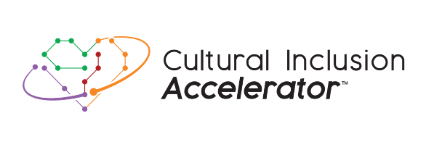
Most Culturally Effective Brands
Industry Progress
2022-2025

Slide 2
Industry Objective Goals –
To spur authentic consumer portrayals and eliminate bias in ads through cultural insights and inclusive reflections among the largest U.S. brands and to inspire the industry to see all consumers, fully understand them, and celebrate their values and true identities.

Slide 3

2024 MCEB Study Overview
115K
170
1400+
450K+
Consumers
Brands
Ads Tested
Ad Evaluations
2023: 80K Consumers
2023: 120 Brands
2023: 1000 Ads Tested
2023: 300K Ad Evaluations
*Asian = 83k Evaluations / 21k Consumers
*Black = 108k Evaluations / 27k Consumers
*Hispanic = 129k Evaluations / 32k Consumers
*Mixed/Other = 20k Evaluations / 5k Consumers
*WNH = 119k Evaluations / 30k Consumers
*LGBTQ = 87k Evaluations / 22k Consumers
*People with Disabilities = 95k Evaluations / 24k Consumers

Slide 4


2024 AWARD CATEGORIES
THREE WINNERS PER CATEGORY
ASIAN
BLACK
HISPANIC ENGLISH
HISPANIC SPANISH
LGBTQ
PEOPLE WITH DISABILITIES
WHITE NON-HISPANIC
MULTICULTURAL & INCLUSIVE
OVERALL POPULATION
AD EFFECTIVENESS

Slide 5
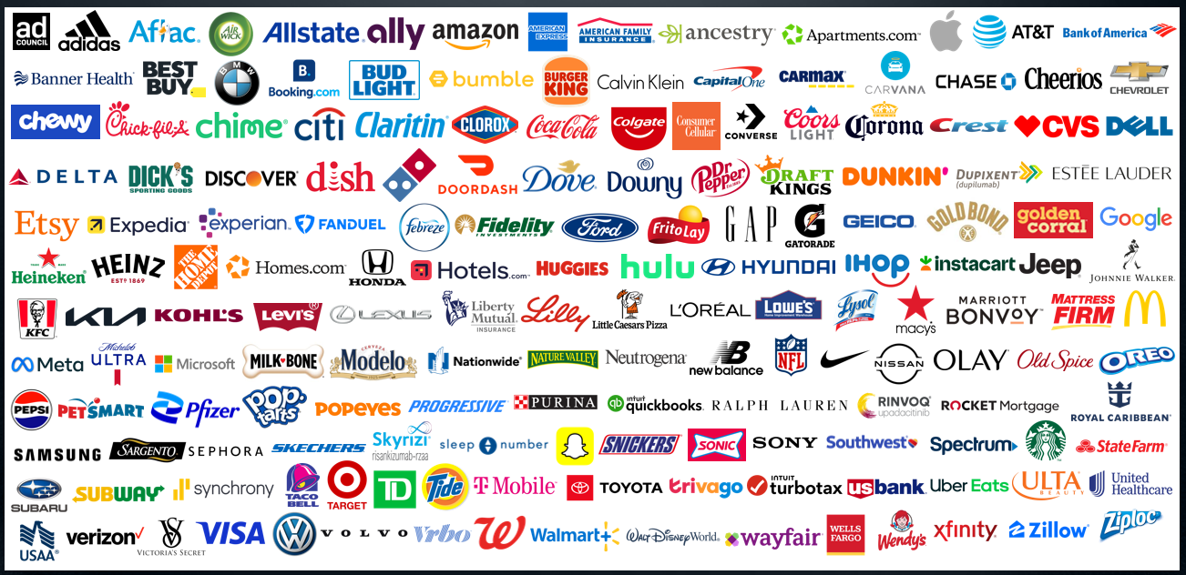
170 Brands Evaluated in 2024

Slide 6



Methodology
MOST CULTURALLY EFFECTIVE BRANDS AWARDS
Brands/Ads
Selection
Ranking
Evaluation
Sampling
170 brands were selected from trade journals’ 2024 rankings of largest ad spenders and Nielsen’s top spenders in diverse segments. Depending on the number of ads publicly available, each brand body of 2024 work was represented by 6-18 ads. The ads were carefully chosen to ensure a diverse representation of all ad campaigns from each brand, with a special emphasis on prioritizing targeted spots.
115K adult consumers from various opt-in online panels representing 7 race/ethnic segments (Asian, Black, Hispanic, Indigenous, LGBTQ, People with Disabilities, and Non-Hispanic White) provided 450K evaluations across 1400+ ads. Segments were augmented and then weighed to their representation in the U.S. Ads were shown in a forced exposure format without media context.
Every curated ad was tested through the CIIMTM and Authentic Inclusivity ScoreTM copy-testing evaluation process, comprising perceived levels of ad effectiveness, cultural relevancy, representation, fairness, and inclusion. An aggregate for all the ads under each brand was calculated to determine a Brand Score which was used to rank the 170 brands by 7 segments and Overall.

Slide 7
Ranking Update
MOST CULTURALLY EFFECTIVE BRANDS AWARDS
2023
2024
CIIM
Authentic Inclusivity Score
Ad Effectiveness

Slide 8
Representation In Ads Has Nearly Doubled Since 2022
+91%
% Increase From 2022 to 2025 Among The Overall Population
N = 3300 Ads Tested From Q1 2022 – Q1 2025

Slide 9
Stereotypical Representations In Ads Has Dropped
22% decrease since 2021
Do you see stereotypical representations of people in advertising?
Source: 2021-2025 CIIMTM Tracker (N = 41506 Consumers)

Slide 10
Purchase Intent Has Been Growing Every Year
+24% Purchase Intent Among Overall Population
N = 3300 Ads Tested From Q1 2022 – Q1 2025

Slide 11
Similarly, Brand Trust Has Increased By 27% Since 2022
+27% Brand Trust Lift Among Overall Population
N = 3300 Ads Tested From Q1 2022 – Q1 2025

Slide 12
Cultural Relevance Continues To Increase Into 2025
2025 Q1
2024 Q1
2023 Q1
2022 Q1
N = 3300 Ads Tested From Q1 2022 – Q1 2025
Offensive | 4th Quartile (Indifferent) | 3rd Quartile (Below Average) | 2nd Quartile (Above Average) | 1st Quartile (Best-In-Class)
Notes:
All CIIM Universe (Not Only MCEB)

Slide 13
Most Culturally Effective Brands Improvement
120 Brands
170 Brands
32%
63%
Offensive | 4th Quartile (Indifferent) | 3rd Quartile (Below Average) | 2nd Quartile (Above Average) | 1st Quartile (Best-In-Class)

